Slide 1
Data Science Capstone Project
Analysis of USA weather Anomalies

Slide 2
Problem Statement
The world is faced with climate change crisis than never before, which is no longer a phenomenon of scientific research but today’s reality. This has been echoed in the recent UN general assembly and in world-wide demonstrations. Climate change is a long-term shift in weather conditions identified by changes in temperature, precipitation, winds, and other indicators. Climate change can involve both changes in average conditions and changes in variability, including, for example, extreme events. Human activity is the main cause of climate change. People burn fossil fuels and convert land from forests to agriculture. Since the beginning of the Industrial Revolution, people have burned more and more fossil fuels and changed vast areas of land from forests to farmland. Burning fossil fuels produces carbon dioxide, a greenhouse gas. It is called a greenhouse gas because it produces a “greenhouse effect”. The greenhouse effect makes the earth warmer, just as a greenhouse is warmer than its surroundings. Carbon dioxide is the main cause of human-induced climate change.t stays in the atmosphere for a very long time. Other greenhouse gases, such as nitrous oxide, stay in the atmosphere for a long time. Other substances only produce short-term effects. Not all substances produce warming. Some, like certain aerosols, can produce cooling. USA is the worst climate polluter according to data from Carbon Brief. Through its current president, it withdrew from the global pact to reduce carbon emissions despite being the number one polluter. This project therefore aims to study weather changes in USA to establish the magnitude of carbon emissions on temperature and precipitation, which will enable current and future stokeholds to open their eyes and reverse the crisis.

Slide 3
Data Description
More than 3 million records of historical US data temperature outliers by date and latitude/longtitude coordinates.
Temperature outliers from 1964-2013. Reporting station ID, name, min/max temperature, as well as degree coordinates of the recorded weather. Original weather data collected from NOAA.
Each entry represents a report from a weather station with high or low temperatures that were historical outliers within that month, averaged over time. Note: This table's columns contain data that was collected from NOAA as well as data that was calculated using Enigma's assortment of weather data. The direct source of the data set can readily be accessed from the URL below:https://data.world/carlvlewis/u-s-weather-outliers-1964/file/weather-anomalies-1964-2013.csv

Slide 4
Data Description: Feature set
Feature label | Feature Description
date_str | Date of temperature recording
degrees_from_mean | Degrees from the mean temperature(temperature outliers)
id | Unique Identification of each temperature
longitude | Longitude of the station name
latitude | Latitude of the station name
max_temp | Maximum temperature recorded at station name on a given date
min_temp | Minimum temperature recorded at station name on a given date
station_name | Name of the station
type | Weather description
serialid | Cummulative identification of each temperature

Slide 5
Methodology
Data loading , preparation and processing
Exploratory Data Analysis
Inferential/Hypothesis testing statistics
Machine learning/ prediction Modelling

Slide 6
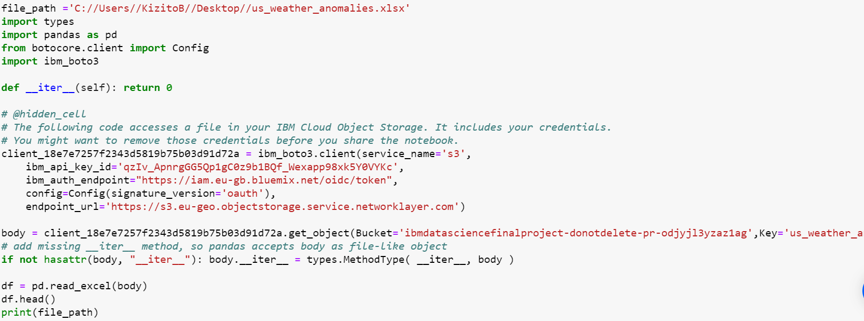
Data loading , preparation and processing

Slide 7
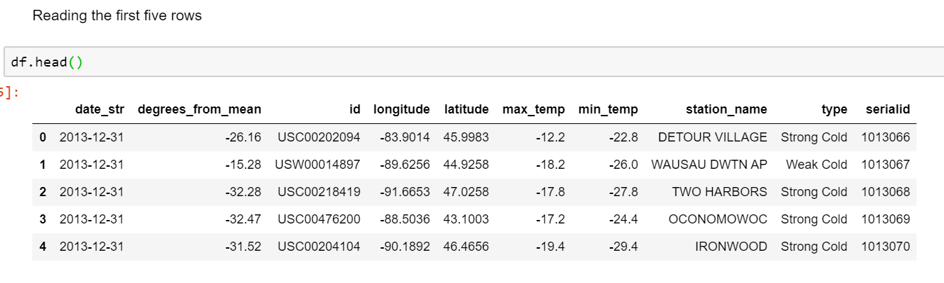
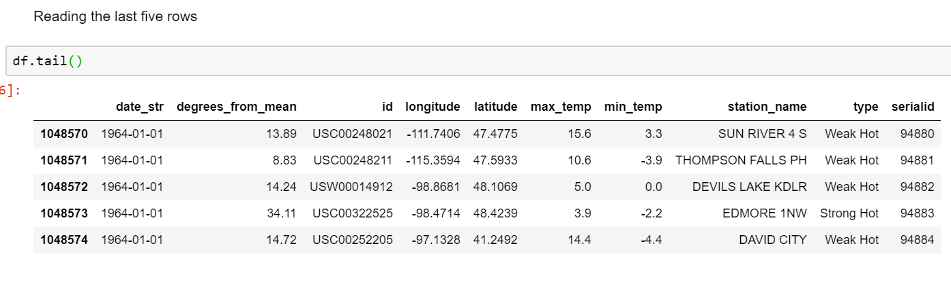
Data loading

Slide 8
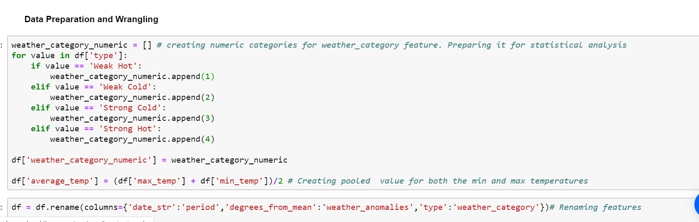
Data Preparation and processing

Slide 9
Exploratory Data Analysis
Histogram
Data summaries
Visual Time series:
Trend analysis
Seasonal analysis
Correlation Analysis

Slide 10
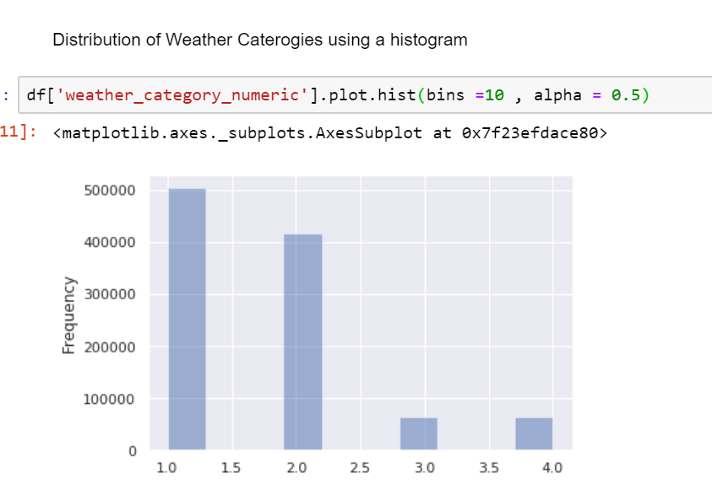
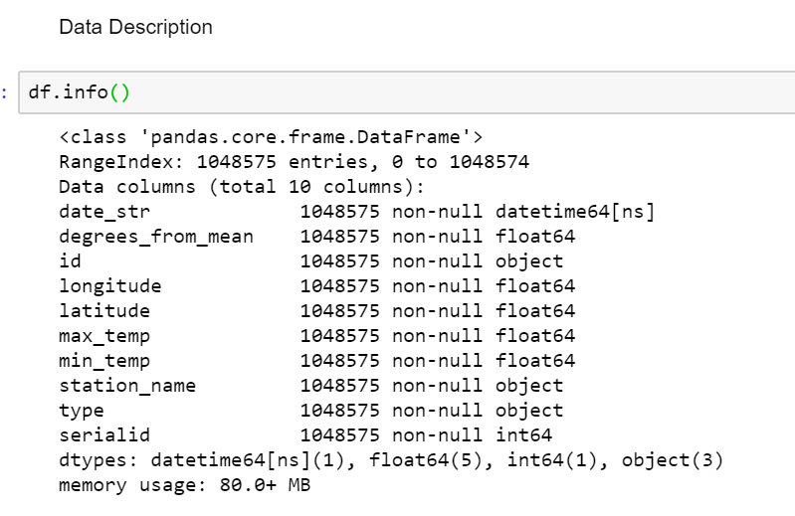
Histogram and Data Description

Slide 11
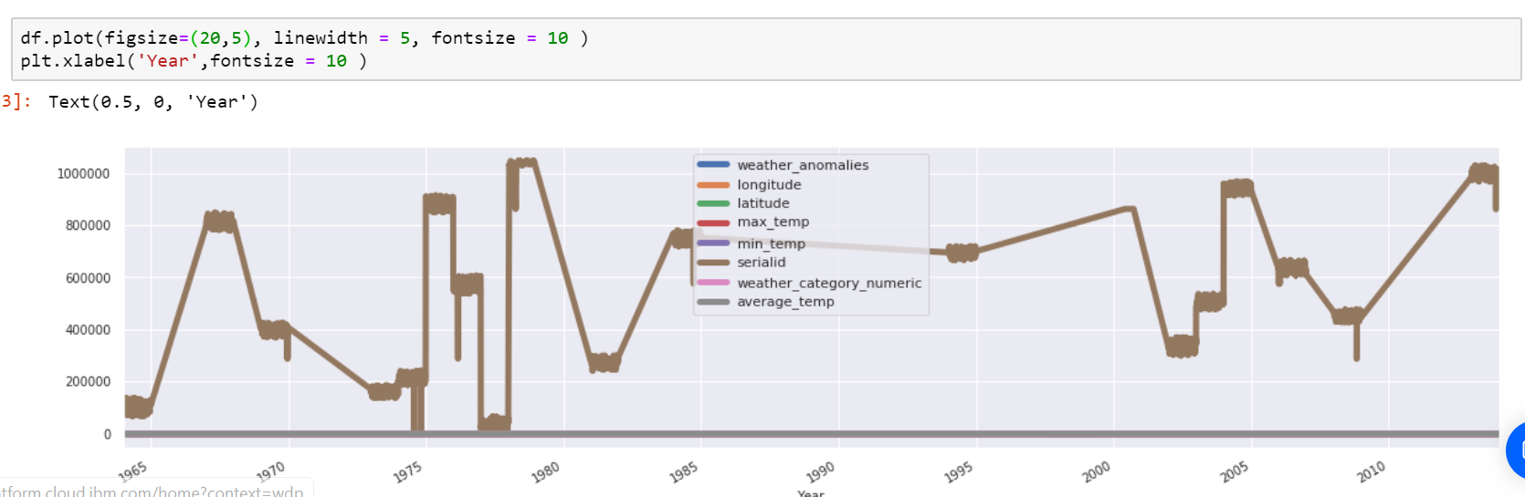
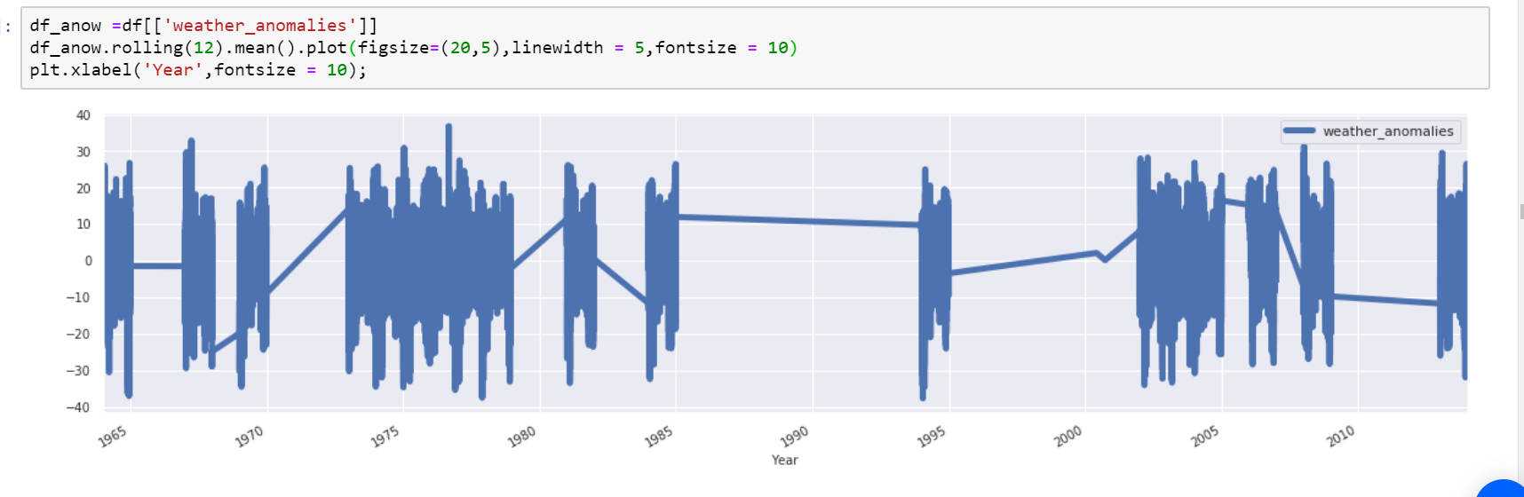
Time series Analysis

Slide 12
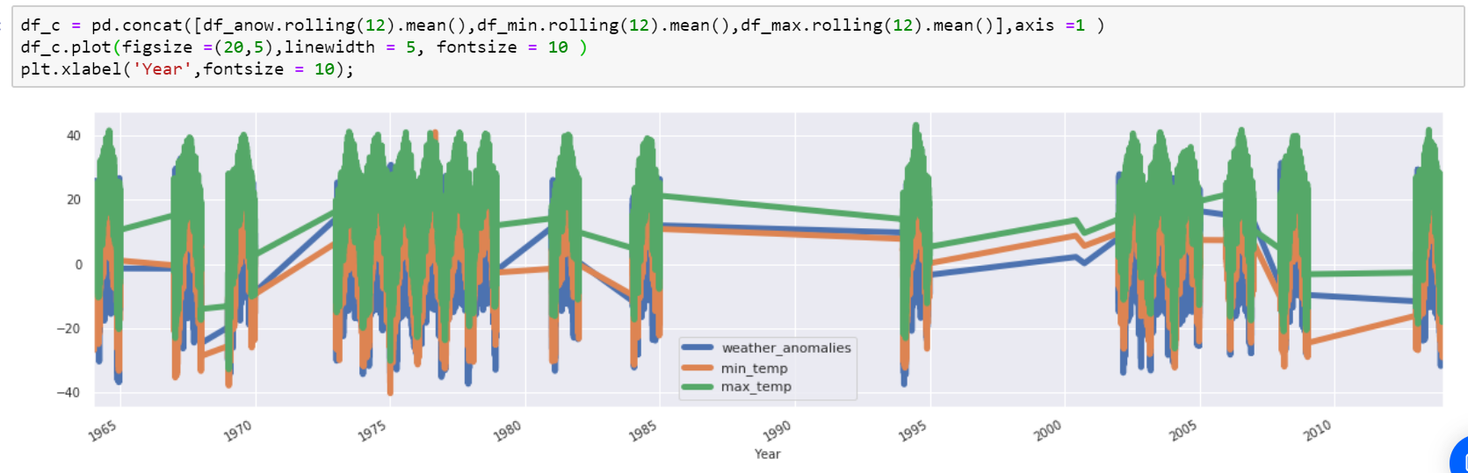
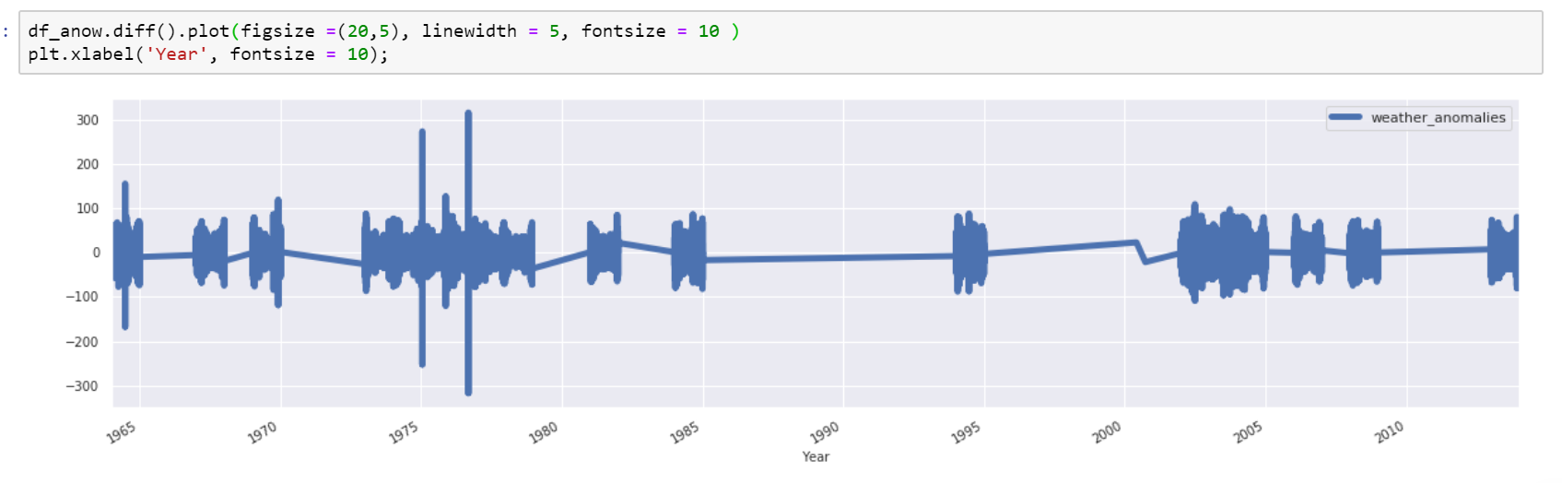
Time series Analysis count…

Slide 13
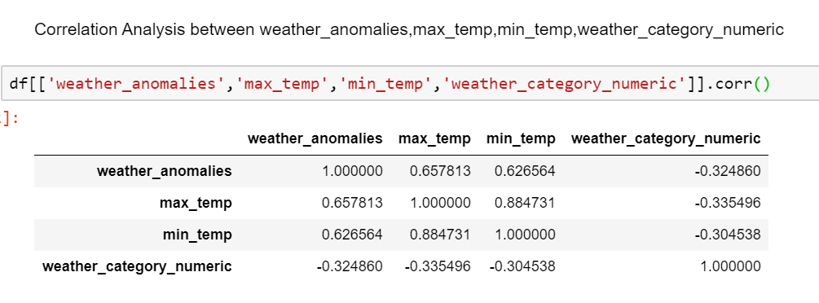
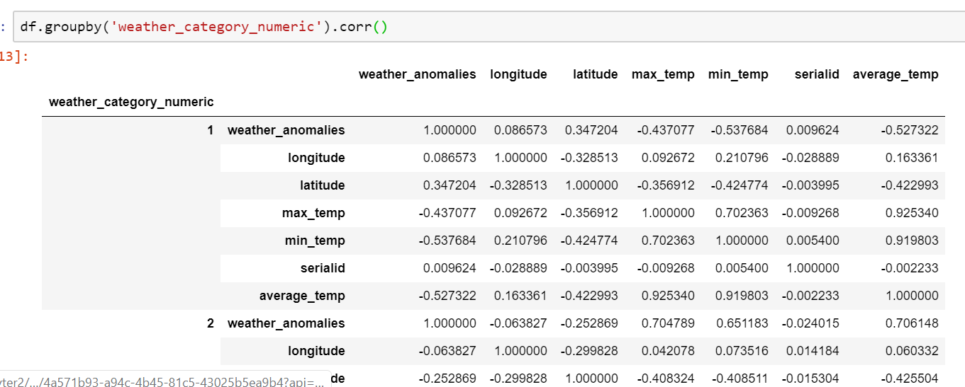
Correlation Analysis

Slide 14
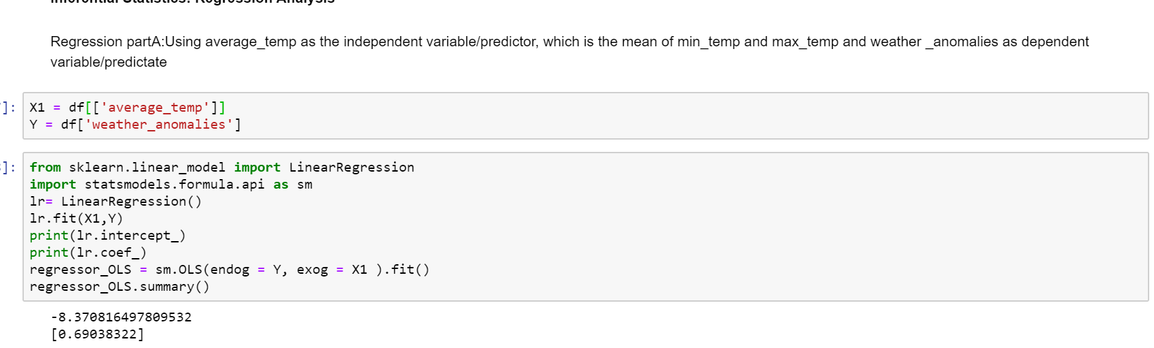
Inferential Statistics

Slide 15
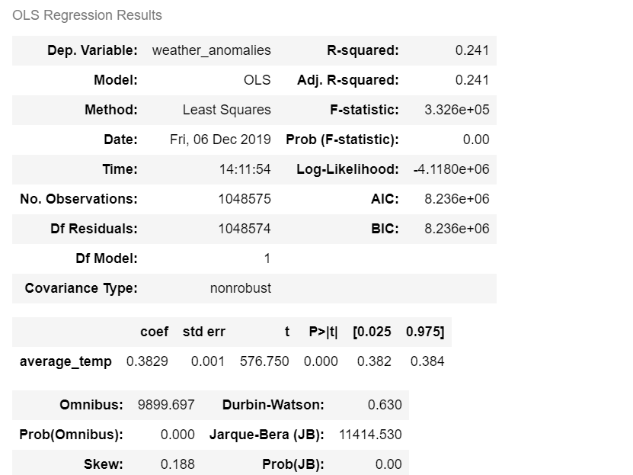
Inferential Statistics count…

Slide 16
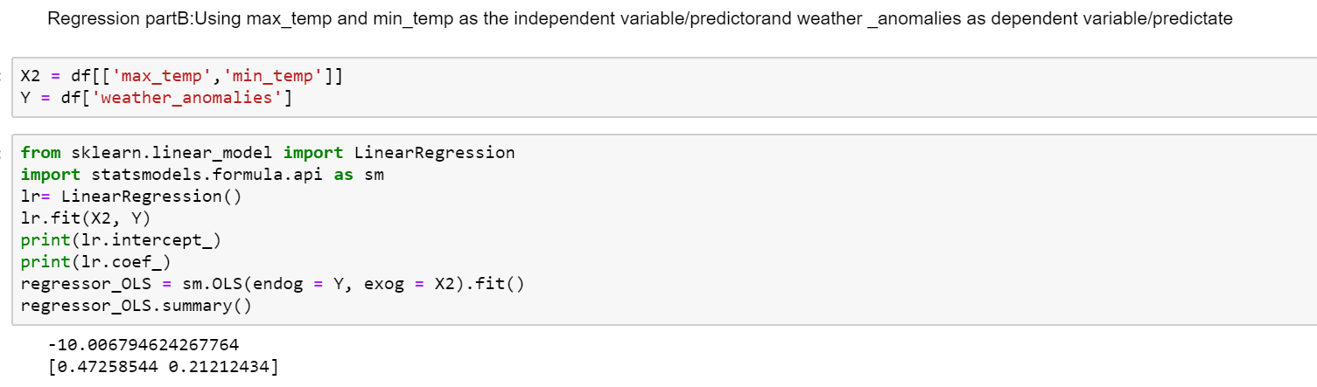
Inferential Statistics

Slide 17
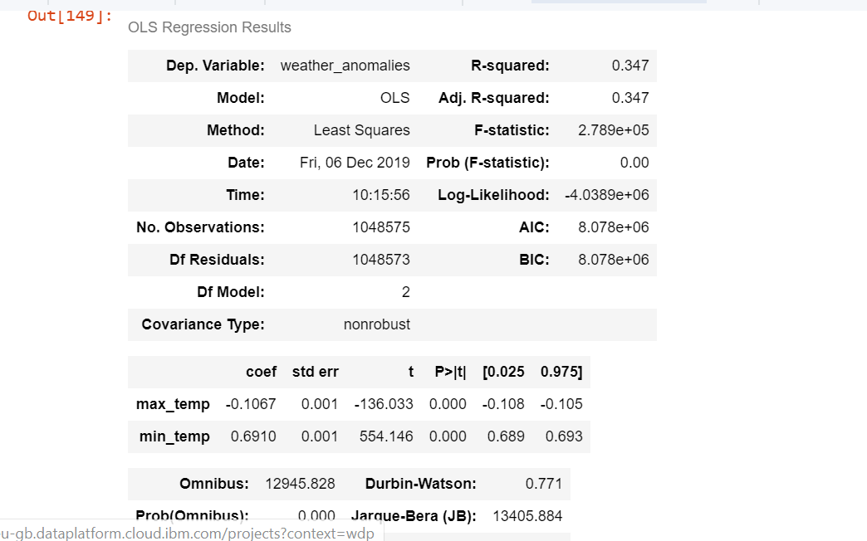
Inferential Statistics

Slide 18
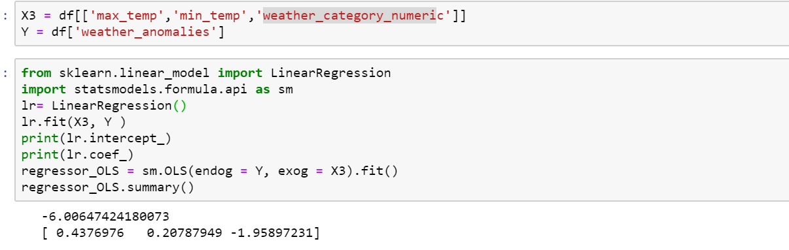
Inferential Statistics

Slide 19
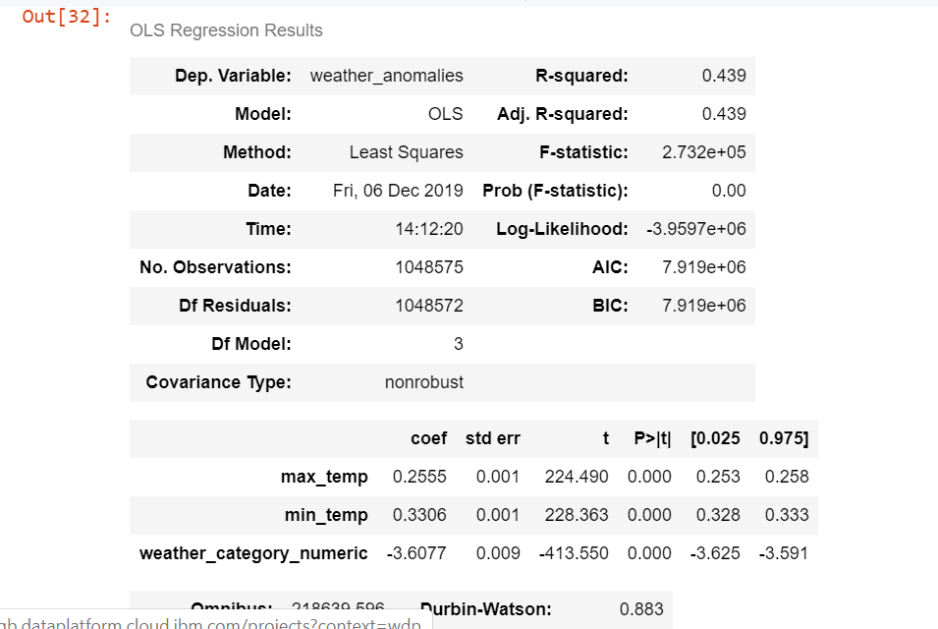
Inferential Statistics

Slide 20
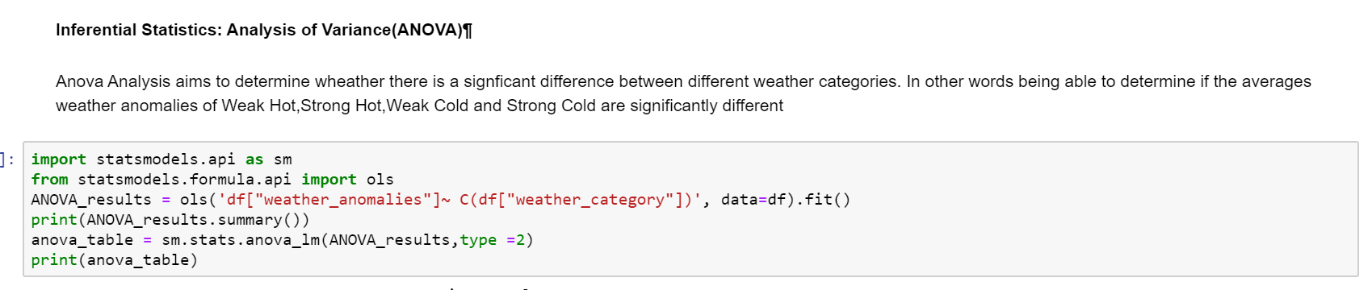
Inferential Statistics: Analysis of Variance

Slide 21
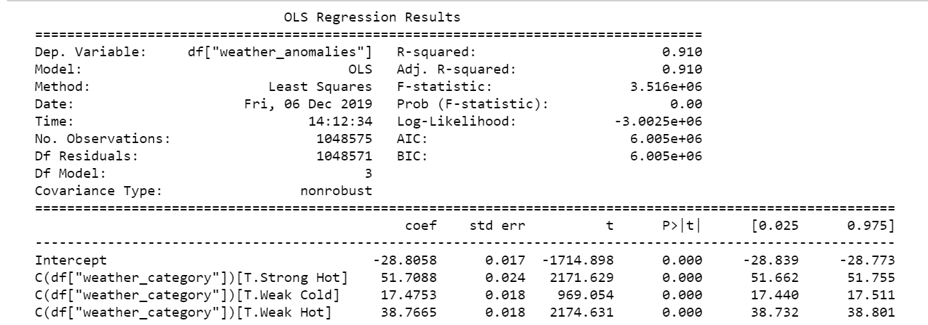
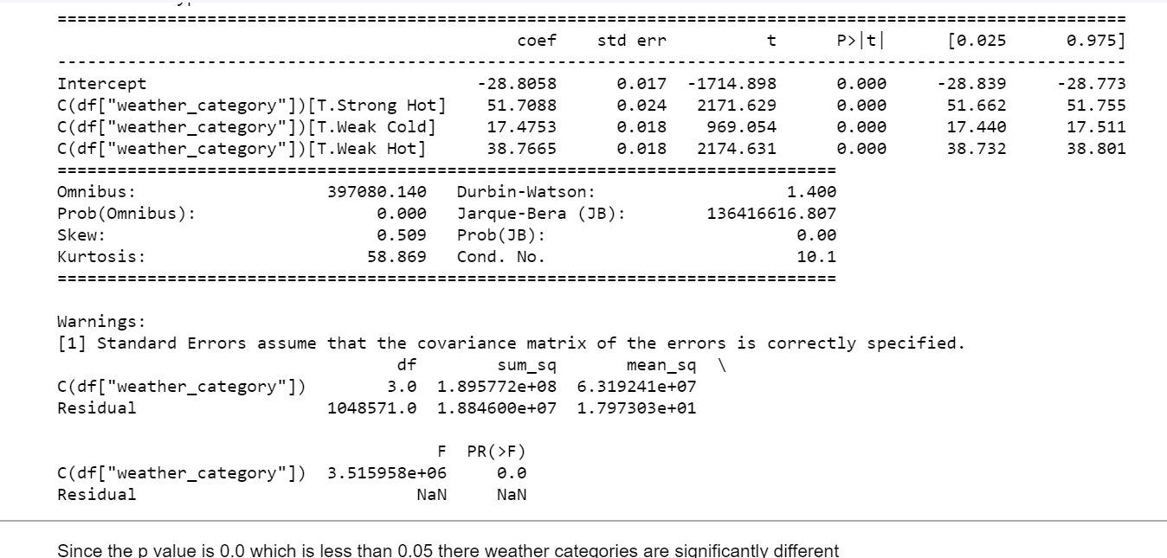
Inferential Statistics: Anova

Slide 22
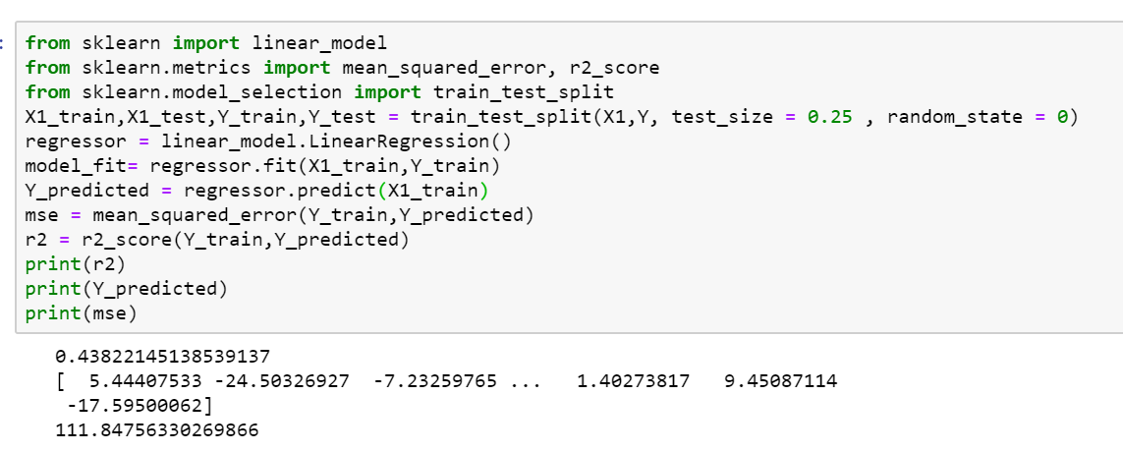
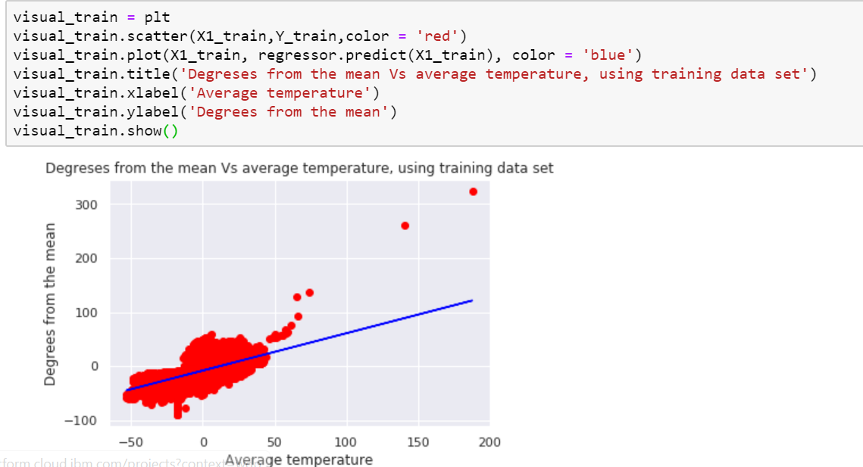
Machine Learning: Regression

Slide 23
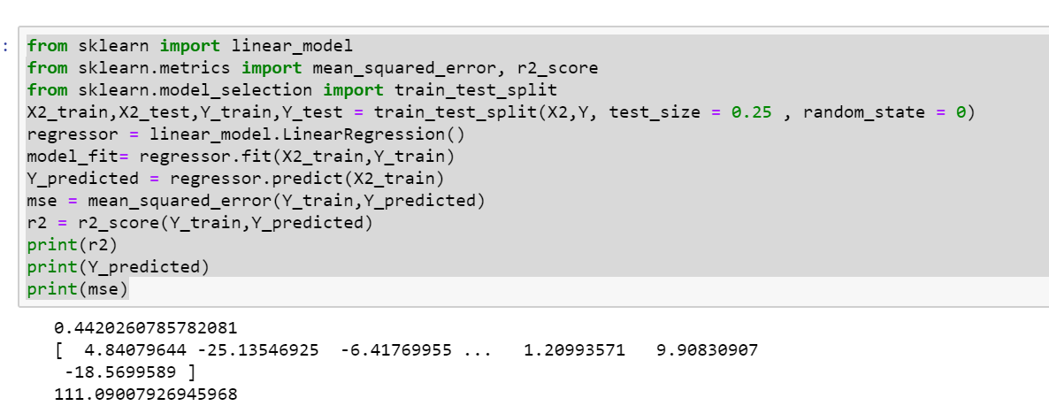
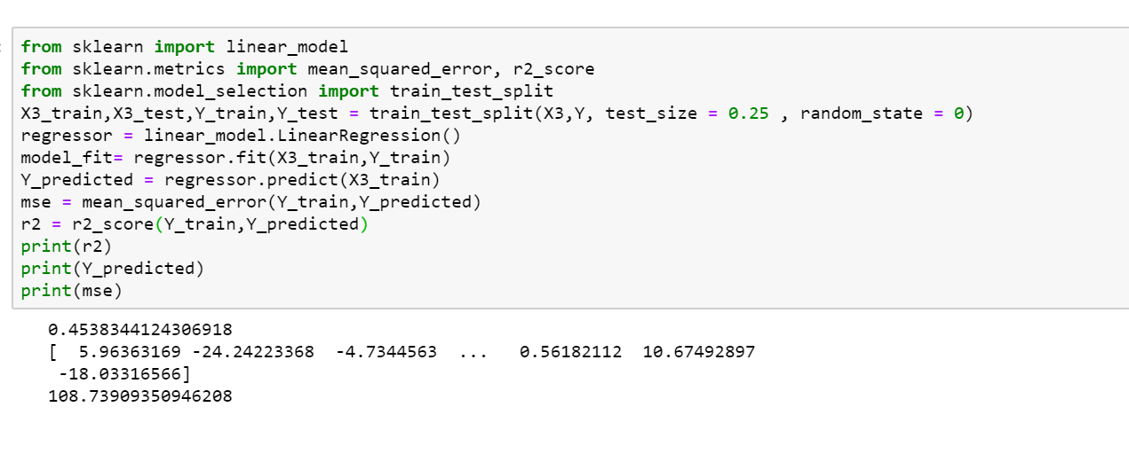
Machine Learning: Regression count…

Slide 24
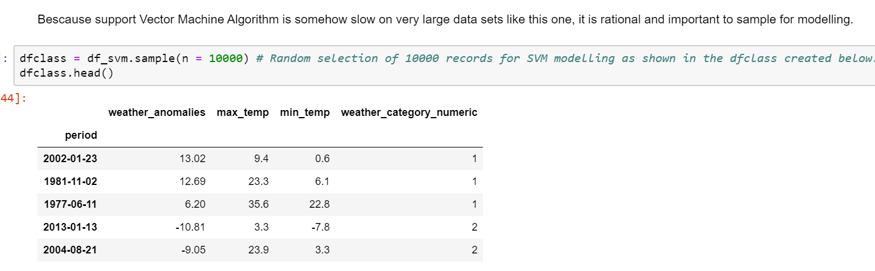
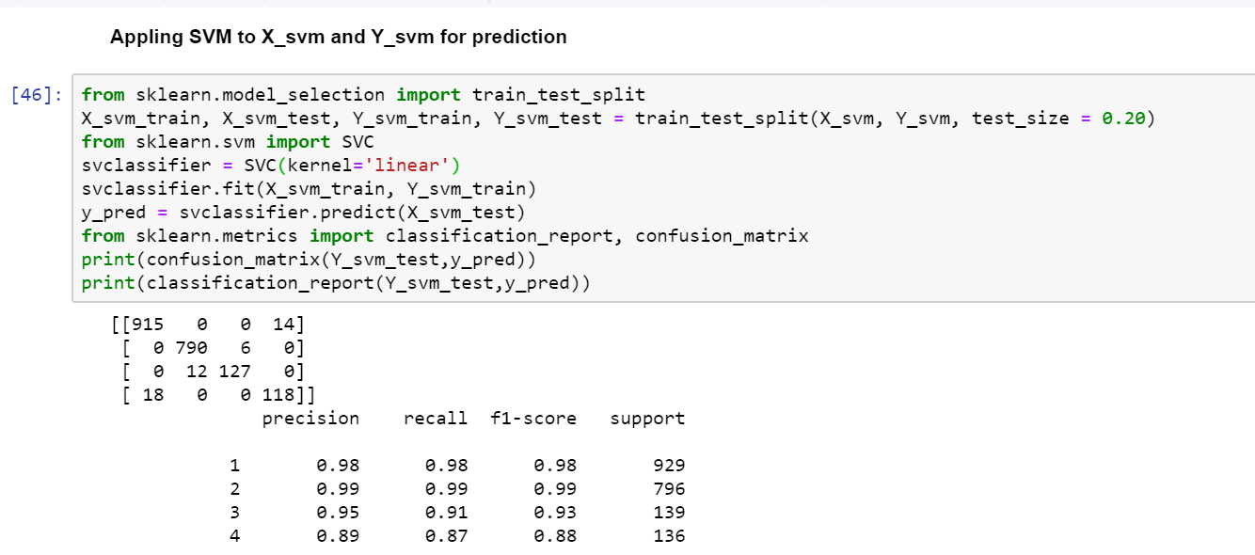
Machine learning:Classification:SVM

Slide 25
Thank You IBM and Coursera.It has been a wonderful experience
Bukenya Kizito
30BKizito@gmail.com

